Slide 1



B.O.P : Code Chef Programming Challenge Flag-off session
17th August 2020
Internal

Slide 2
Agenda
Time | Agenda
2.00 PM – 2.05 PM | HSE Moments
2.05 PM – 2.10 PM | Opening Remarks by Mr. Prakash Kumar - Head NervCentre, GTS
2.10 PM – 2.15 PM | Context Setting by Mr. Fauzy Omar Basheer – Head Facility of the Future, GR&T
2.15 PM – 2.45 PM | Code Chef briefing by Shahriza Khairudin & Petrus Tri Bhaskoro
2.45 PM – 3.00 PM | Q&A Session
Internal

Slide 3
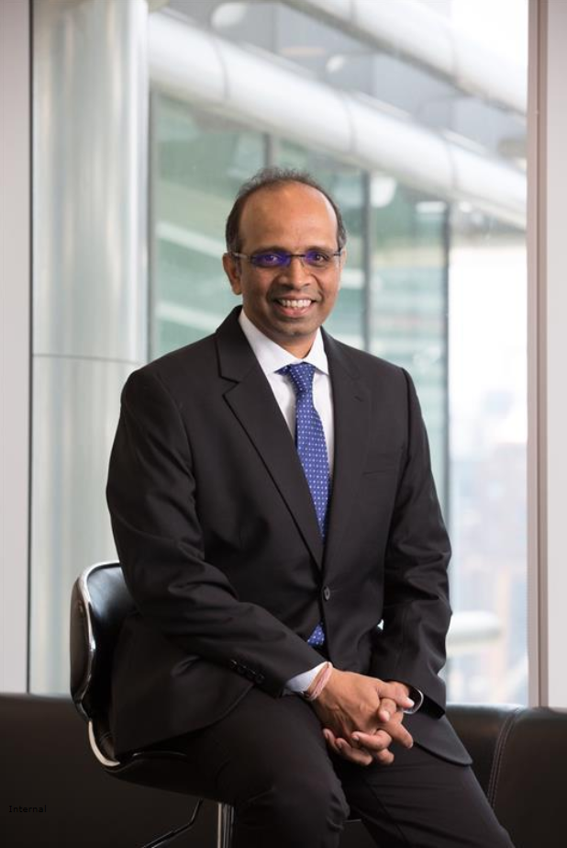
Opening remarks by :
MR. PRAKASH KUMAR
Head of NervCentre
Group Technical Solutions
Internal

Slide 4
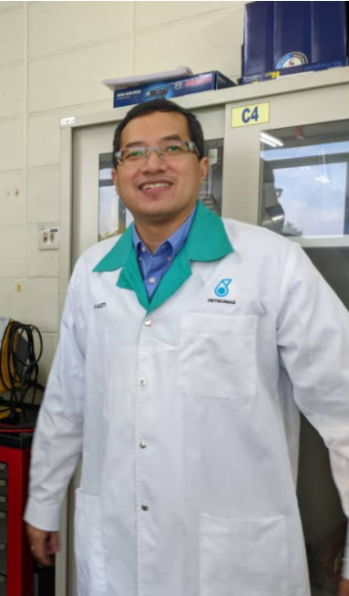
Context setting by :
MR. FAUZY OMAR BASHEER
Head Facilities of Future
Group Research & Technology
Internal

Slide 5


Rules and Regulations
Rules & Regulations
The competition is open to all PD&T members only. There is no minimum/ maximum age requirement for entry.
Each applicant/ team will be required to complete and submit application/commitment form. Max 3 members per team.
Submitted work must be a novel and original work and not yet in production for commercial gain. The entrant is responsible for the specifications of the programming which cannot include copyright protected material.
Teams can only submit a single solution for each problem. The solutions must be submitted via email to shahriza.khairudin@petronas.com and syuhadah_msaid@petronas.com .
With subject contains “CODE CHEF <Team Name> SOLUTION LEVEL <1/2/3>”
All solutions must be successfully submitted before 11:59:59 pm of respective progress level dateline. Team that fails to meet the dateline will be penalized through point deduction.
Source code and output graphical results shall be attached together in the email. Once submitted they may not be changed!
Teams may not seek hints and/or ask for leads during the contest. They may, however, submit questions about procedure and/or seek clarification, in writing, to the Contest Committee via Microsoft Teams group channel- PD&T CODE CHEF. This will ensure that all teams receive the same information as deemed necessary.

Slide 6
Evaluation
All teams will be given the same set of problems to solve.
The contest will consist of multiple rounds, each round will have specific jaw dropping rewards . The more difficult the problem, the BIGGER the rewards of a correct solution.
Contestants shall present a short 15-minute virtual demo of their programming solution for each level to the Contest Committee. Several slots will be available for selection. The result will be announced prior to next checkpoint.
Rewards will only be given to the team with correct solution output.
Programs will be tested by minimum three independent judges (appointed by the Contest Committee) by running them against a set of test data.
Programs will be judged and awarded credits based on criteria given. Each level carries different weightage in contributing to overall score.
The Contest Committee will tally the scores for each team and publish ranking at every round. The team with the highest scores will be declared the winner and will be rewarded with ULTIMATE PRIZE. The Contest Committee's decision in all matters is final.
Judging Criteria | Weightage
Accuracy of result | 50 points
User interface & functionality | 30 points
Code quality | 20 points
Internal

Slide 7






Code Chef Timeline
Beyond Office Program
CODE CHEF
In collaboration with NervCentre GTS
CODE CHEF Flag Off & Briefing
Level 1 Checkpoint & Submission
Level 2 Checkpoint & Submission
Level 3 Checkpoint & Submission
Evaluation by
Judging Committee
Closing & Reward Ceremony
Campaign Started
5th Aug 2020
17th Aug 2020
24th Aug 2020
4th Sept 2020
18th Sept 2020
25th Sept2020
30th Sept 2020
Internal

Slide 8
Use Case
Wax deposition in pipeline is one of main challenges in most of PETRONAS’s waxy fields i.e. D12, Dulang, Gumusut, etc. For efficient wax mitigation strategies, wax deposition models in transient simulator such as OLGA must be able to accurately predict wax deposition. Improvement on current wax deposition model especially with respect to Malaysian waxy crude is crucial to ensure the model’s accuracy (our crude is unique and not available in other part of the world)
To support this model development, wax deposition experiments using PRSB’s flowloop coupled with wax loop calculator are needed.
In addition to that, it also can be used by new projects during development phase (experiments to be conducted ONLY using PRSB’s flowloop).
The software can also serve as a quick validation and verification in-house tool to check and compare the performance of existing and newly developed wax deposition model (by OTHERS)
Problem Statement
Objectives
To develop PRSB’s Wax Loop Calculator to calculate the amount of wax deposit in PRSB’s flow loop using Matzain (widely accepted) model
Software code could be written in C / Python (preferred language) and to cover all steps as per the given algorithm.
The software should be created with consideration to PETRONAS cloud system and architecture for integration purpose. – Bonus points
The software should be able to read data from external (input) files (excel - for dataset and property table and notepad - for fluid and wax files).
The software should be created in such a way to ease debugging (for any possible error) and future development process (Reusable function & minimal line of codes ).
Programming
Requirements
Correctness: The code will be reviewed to ensure the correctness of the model and the calculation steps.
Software performance: The software will be tested using PRSB flow loop dataset (will be provided) and compared against existing equivalent wax calculator.
Simulation time: The software will also be assessed based on the processing time – the faster the better
Outputs: As per the algorithm in both table and graphical forms
Proper comments / remarks for the code / function – user friendliness
Optimized line of codes
Success Criteria
Internal
Notes:
“A progressive energy & solutions partner enriching lives for a sustainable future”
Solutions developed based on pain points from Asset through SR by Discipline
No integration cross-discipline
Duplication of efforts for same intend
Solution deployed once off to Asset, post successful Pilot, own drive to scale-up at other Asset
No entity within GTS overlooking strategically at the totality of solutions
Potential loss of optimizing infrastructure cost
Potential loss of maximizing solution capability to be prescriptive
Potential loss of capability if dependent on single engineer, without proper sustainability plan
Looking for the future proofed program, wholesome - Capability, Organizational Improvement & Change Management in ensuring sustainability, with maximum value where we enrich lives, within and beyond GTS, delivering at pace through digitalization – where we remain as the progressive energy & solutions partner to our asset and biz.
Filter
Technical & commercial viable value, applicability, scalability
Must challenge the team – descriptive, predictive, prescriptive – developing hi-grading potential
Developing the associated program requirement structure
Technical challenge – is this tried/tested, TRL Process.
Commercial – cost, annual ROI,
Scaleability – once off, applied across biz sectors.
What to do after that – helping to define that program with clarity.
Coordinating with stakeholders biz stakeholders (DBE, Upstream, GNE). Coordinating with GD.
Vision – assembly line or one stop centre.

Slide 9
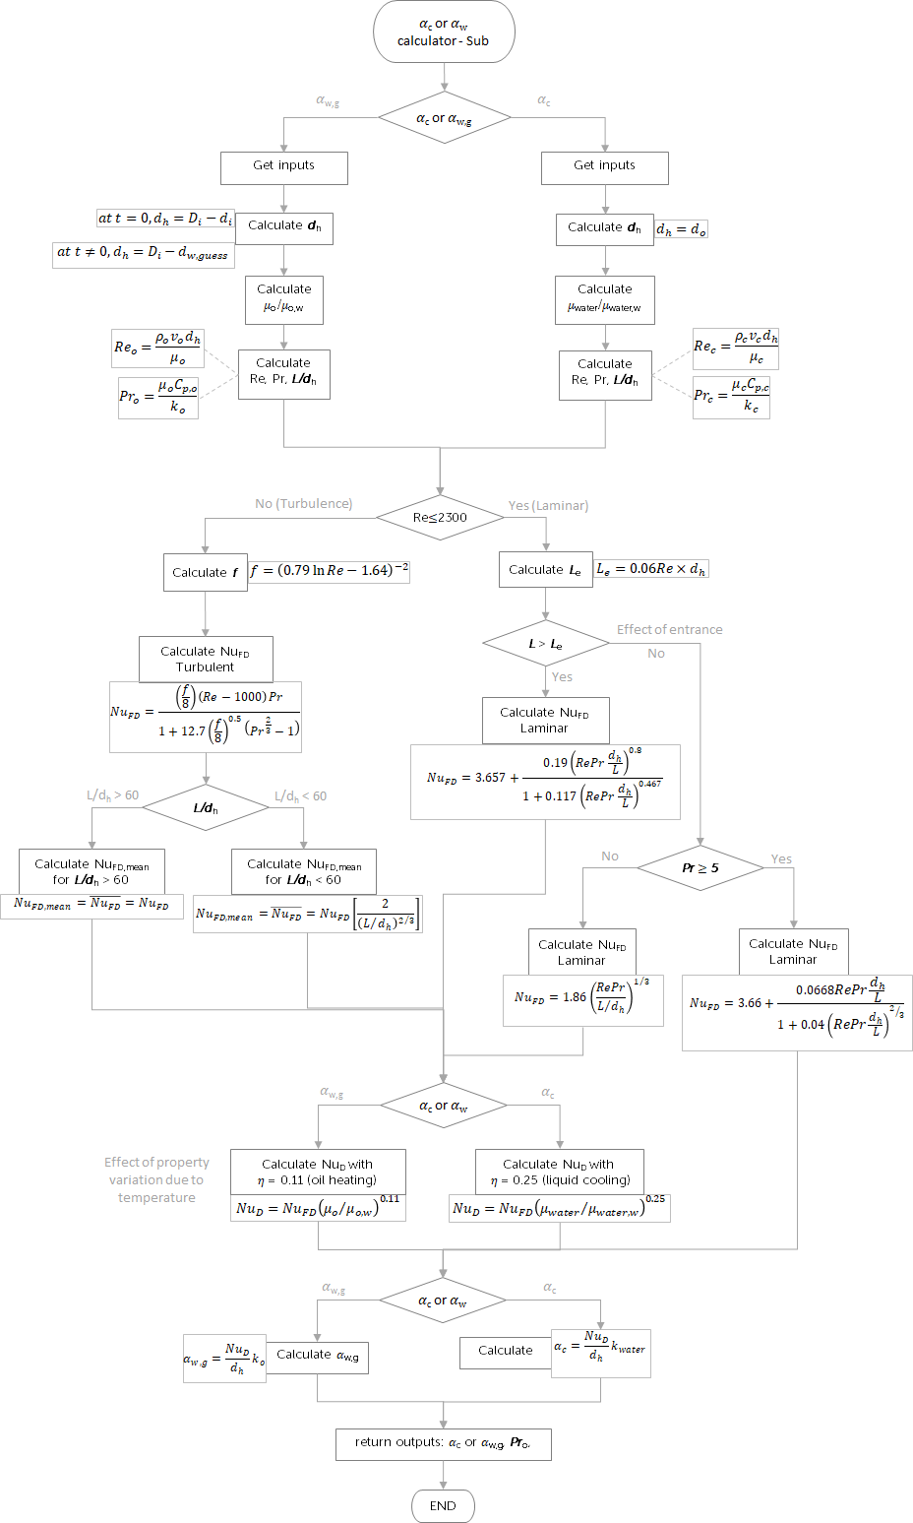
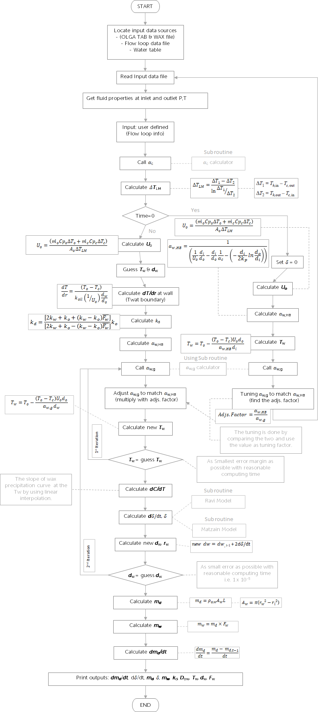
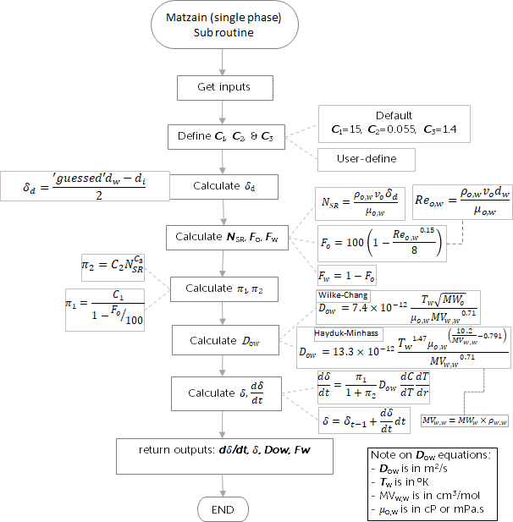
Wax Loop Calculator algorithm
* Requires integration with level 1 and level 2
Level 2 (Sub routine algorithm)
Level 3 (Main algorithm)
Level 1 (Matzain – single phase) Sub routine
Rank : Easy
Duration : 1 week
Team Points : 20 %
Rank : Medium
Duration : 2 week
Team Points : 30 %
Rank : Hard
Duration : 2 week
Team Points : 50 %
Internal

Slide 10
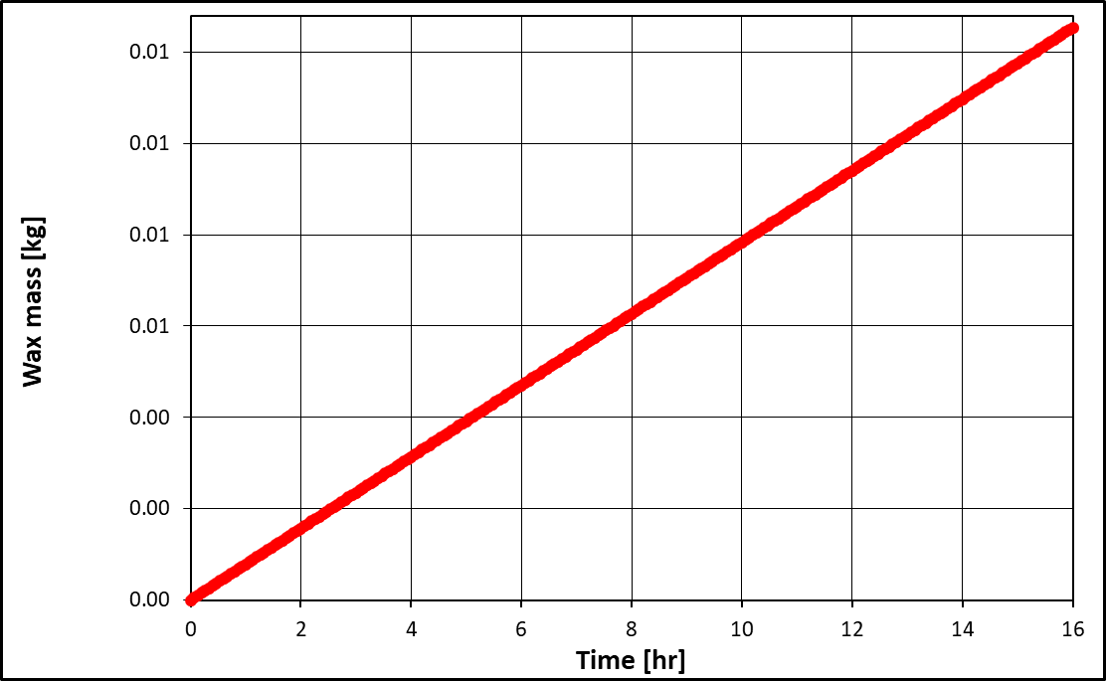
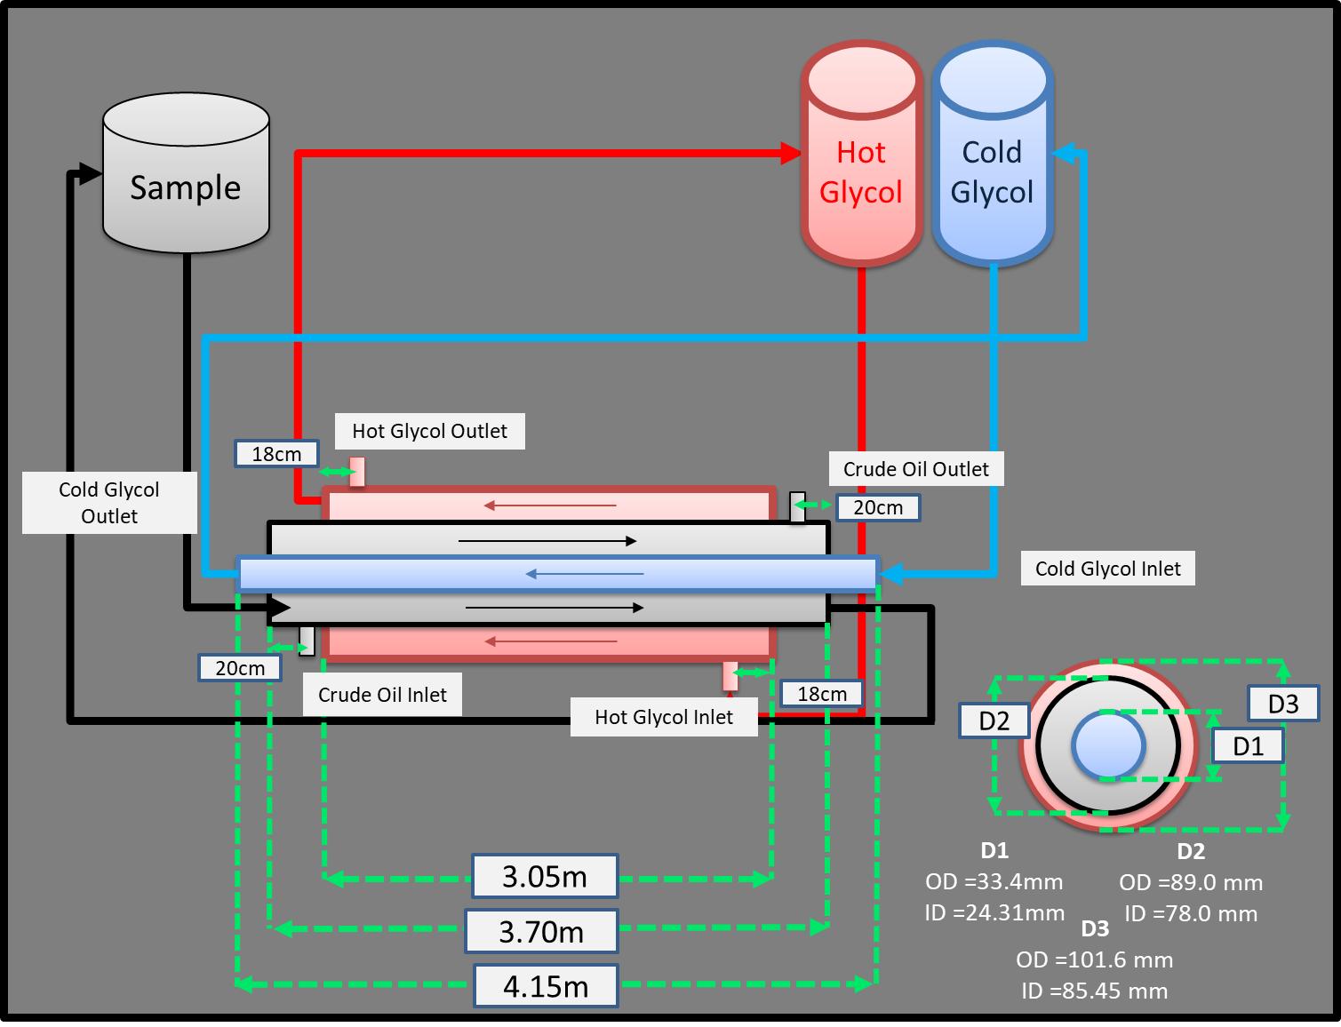
How to start and what are the expected result ?
User Interface design
Information and Dataset for level 1
Level 1 algorithm
Fluid and wax files from selected waxy crude oil and list of abbreviation
Coolant table
Dataset
Additional wax’s density table
Flow loop configuration and dimension
Inputs:
Wax model: fluid & wax files, deposition model, wax diffusion model
Coolant (water) table
Experimental setting data
Flow loop dimension (user define)
Input: Flow Loop Configuration
Output: Graphical Results
Output: Data Table
m_{h}
m_{o}
m_{c}
T_{h,i}
T_{c,i}
T_{o,i}
T_{o,o}
L = 3m
T_{c,o}
T_{h,o}
Internal

Slide 11

Question & Answer
Internal

Slide 12
Thank you for your passion!
Let’s get the challenge rolling !
Internal

